Slide 1
Flexible Bit Streams for Ubiquitous Multimedia Medical Applications
Benoit Macq
Professor
Université catholique de Louvain
2003 NAIST-COE International Symposium

Slide 2
The classical digital multimedia communication
The image, sound and speech signals are compressed, multiplexed and encrypted at a fixed rate determined by the channel capacity and/or the server space
The basic paradigm is the rate-distortion framework (the more the rate the less the distortion)
Example: JPEG, MPEG-1-2-4 compression of images
2003 NAIST-COE International Symposium
<number> / 10

Slide 3

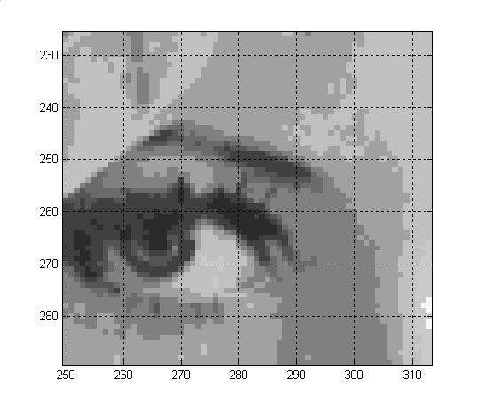
Input Image, Size=512 x 512 x 8 bits
2003 NAIST-COE International Symposium
<number> / 10

Slide 4
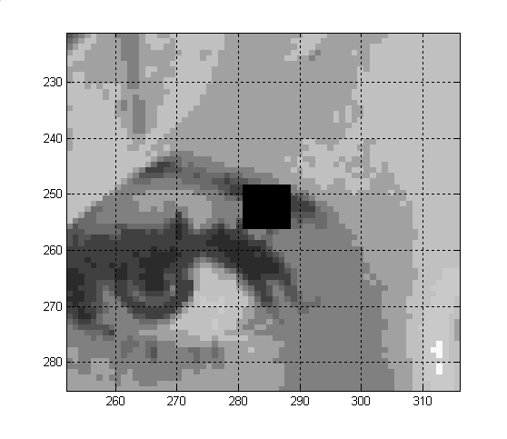
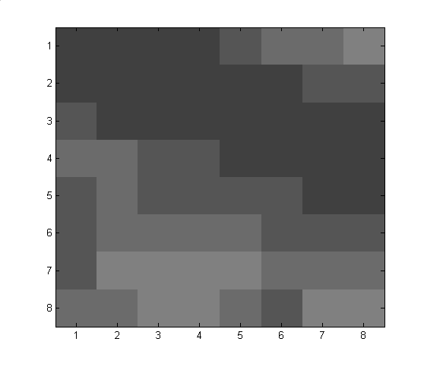
Image Close-up
Block to be studied
2003 NAIST-COE International Symposium
<number> / 10

Slide 5

Transform coding
Discrete Cosine Transform
(DCT)
  8x8 pixels block
  8x8 DCT coefficients block
  Lossless transform
  Decorrelation
  = more information in
  fewer coefficients
Wavelet Transform
Subband Decomposition
Pyramidal Decomposition
2003 NAIST-COE International Symposium
<number> / 10

Slide 6
DCT image compression
DCT: discrete cosine transform + quantization + 2-D entropy coding
DCT
Entropy
Coder
Quant.
2003 NAIST-COE International Symposium
<number> / 10

Slide 7

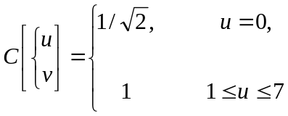
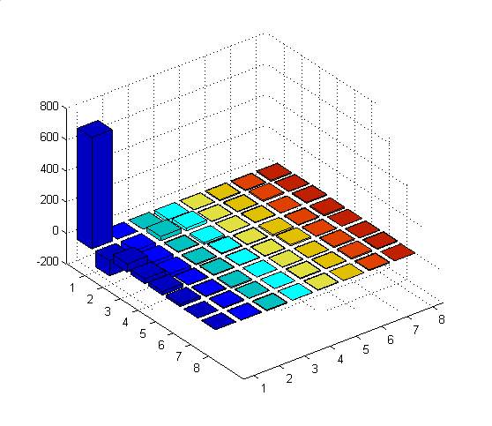
69 71 74 76 89 106 111 122
59 70 61 61 68 76 88 94
82 70 77 67 65 63 57 70
97 99 87 83 72 72 68 63
91 105 90 95 85 84 79 75
92 110 101 106 100 94 87 93
89 113 115 124 113 105 100 110
104 110 124 125 107 95 117 116
717.6 0.2 0.4 -19.8 -2.1 -6.2 -5.7 -7.6
-99.0 -35.8 27.4 19.4 -2.6 -3.8 9.0 2.7
51.8 -60.8 3.9 -11.8 1.9 4.1 1.0 6.4
30.0 -25.1 -6.7 6.2 -4.4 -10.7 -4.2 -8.0
22.6 2.7 4.9 3.4 -3.6 8.7 -2.7 0.9
15.6 4.9 -7.0 1.1 2.3 -2.2 6.6 -1.7
0.0 5.9 2.3 0.5 5.8 3.1 8.0 4.8
-0.7 -2.3 -5.2 -1.0 3.6 -0.5 5.1 -0.1
2003 NAIST-COE International Symposium
Step 1: DCT
<number> / 10

Slide 8
717.6 0.2 0.4 -19.8 -2.1 -6.2 -5.7 -7.6
-99.0 -35.8 27.4 19.4 -2.6 -3.8 9.0 2.7
51.8 -60.8 3.9 -11.8 1.9 4.1 1.0 6.4
30.0 -25.1 -6.7 6.2 -4.4 -10.7 -4.2 -8.0
22.6 2.7 4.9 3.4 -3.6 8.7 -2.7 0.9
15.6 4.9 -7.0 1.1 2.3 -2.2 6.6 -1.7
0.0 5.9 2.3 0.5 5.8 3.1 8.0 4.8
-0.7 -2.3 -5.2 -1.0 3.6 -0.5 5.1 -0.1
÷
16 11 10 16 24 40 51 61
12 12 14 19 26 58 60 55
14 13 16 24 40 57 69 56
14 17 22 29 51 87 80 62
18 22 37 56 68 109 103 77
24 35 55 64 81 104 113 92
49 64 78 87 103 121 120 101
72 92 95 98 112 100 103 99]
Q
Step 2: Quantization
45 0 0 -1 0 0 0 0
-8 -3 2 1 0 0 0 0
4 -5 0 0 0 0 0 0
2 -1 0 0 0 0 0 0
1 0 0 0 0 0 0 0
1 0 0 0 0 0 0 0
0 0 0 0 0 0 0 0
0 0 0 0 0 0 0 0
2003 NAIST-COE International Symposium
<number> / 10

Slide 9
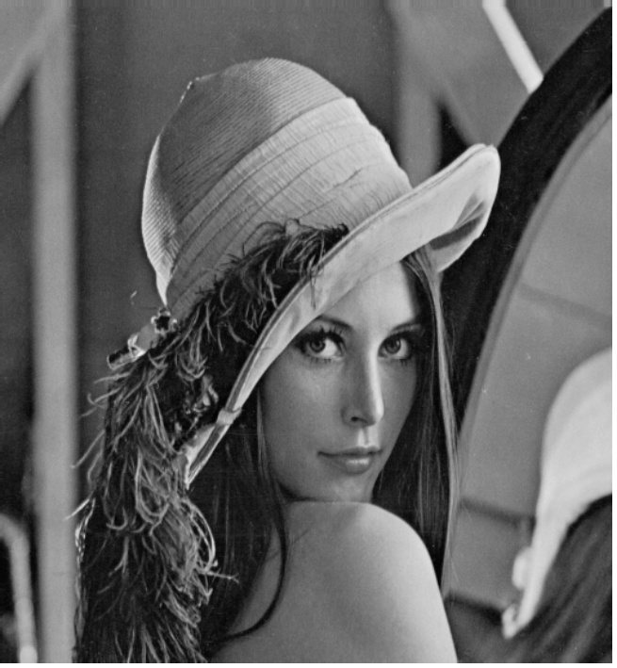

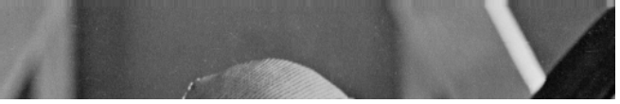
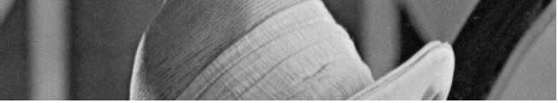
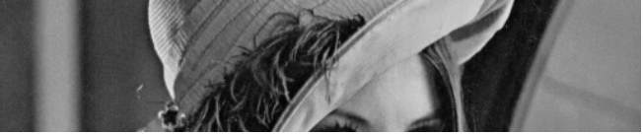
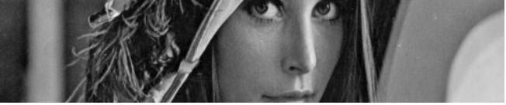
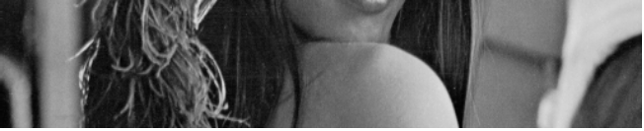

The scheme is not flexible !!!
262 kBytes 13 kBytes (1:20)
2003 NAIST-COE International Symposium
<number> / 10

Slide 10
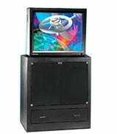
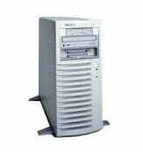
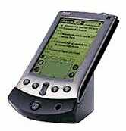
Ubiquitous medical multimedia communications
R
R
R
Operation Room
R
Media Server
Media Streams
PDA
Intermediate Nodes
Transcoding
Destination Node
2003 NAIST-COE International Symposium
<number> / 10

Slide 11
The need for flexible bit streams
One idea would be to replace compression at a fixed bit rate (giving certain distortion) with a flexible bit streams, the first step is the multiresolution approach
Coding
Smart
Filter
Multiresolution Transform
Multiresolution
2003 NAIST-COE International Symposium
<number> / 10

Slide 12
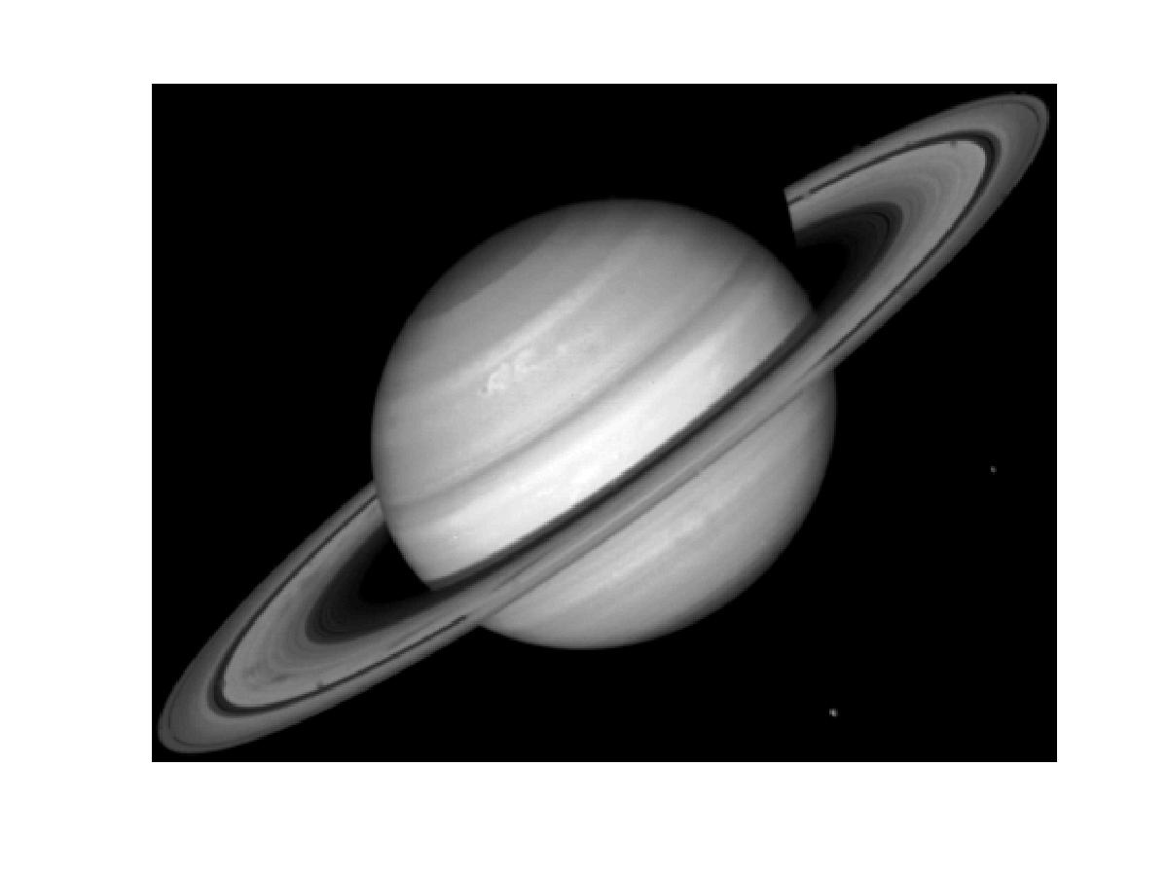
2003 NAIST-COE International Symposium
<number> / 10

Slide 13
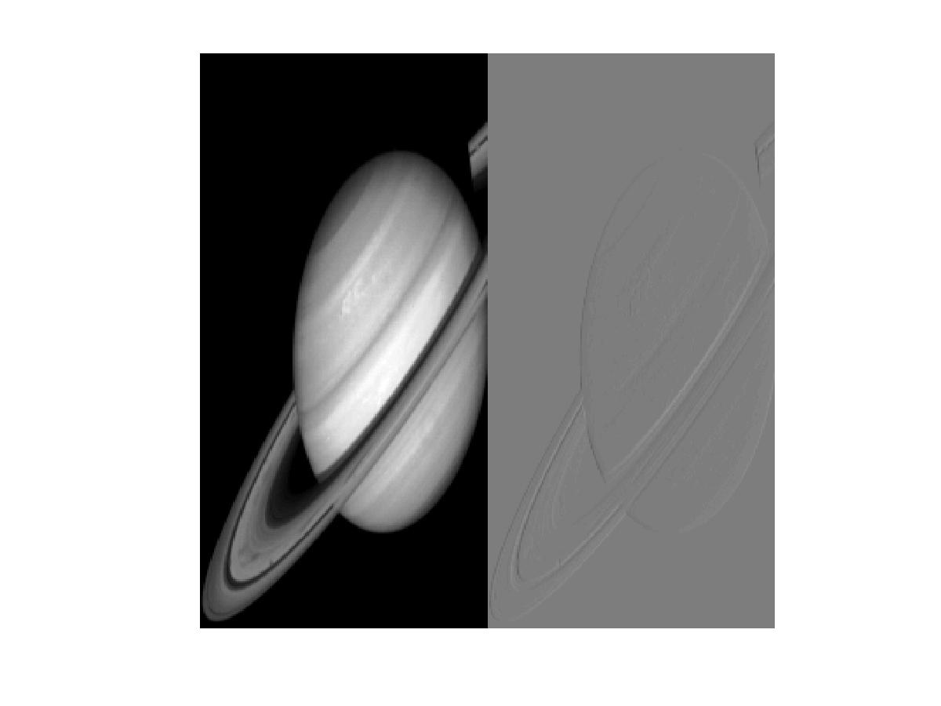
Multiresolution pyramids
2003 NAIST-COE International Symposium
<number> / 10

Slide 14
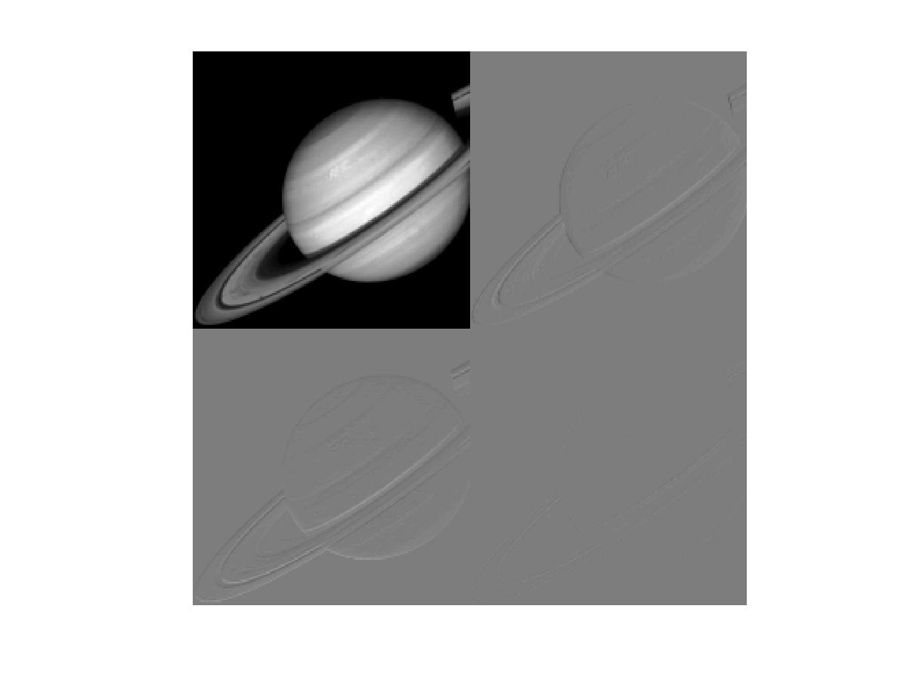
2003 NAIST-COE International Symposium
<number> / 10

Slide 15
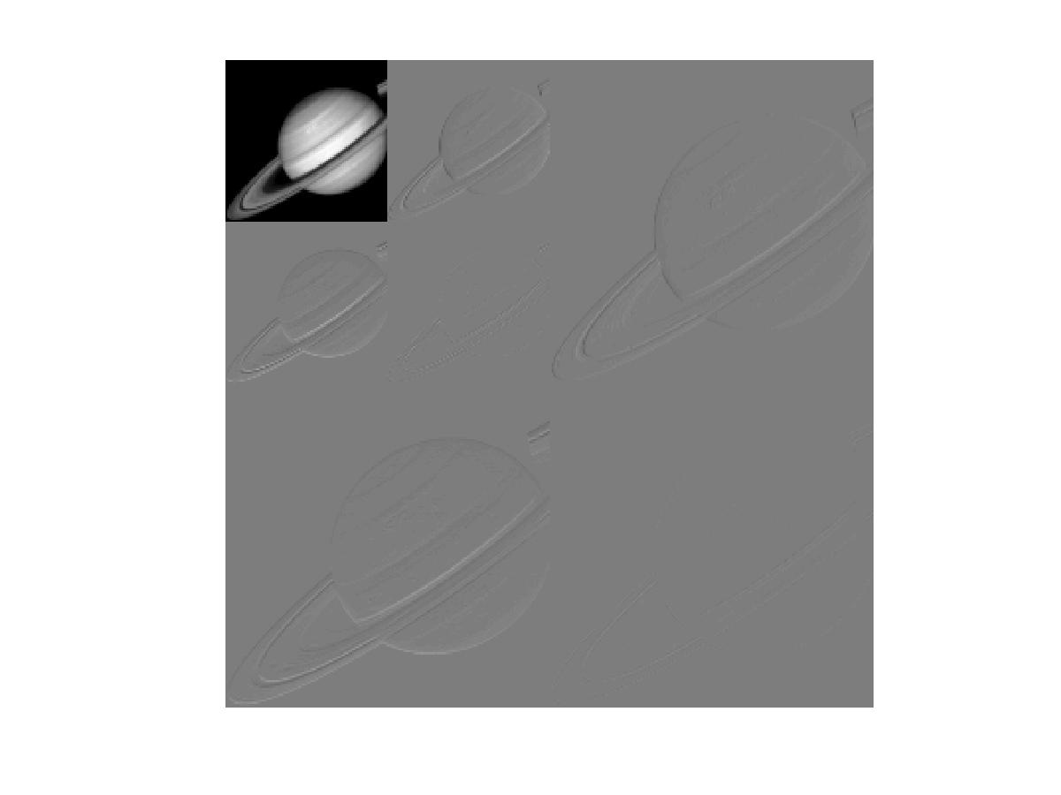
2003 NAIST-COE International Symposium
<number> / 10

Slide 16
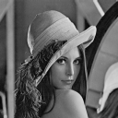
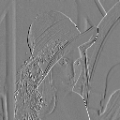
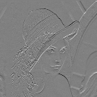
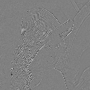

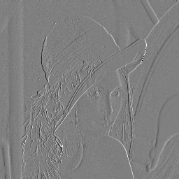
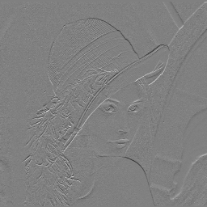

Multiresolution compression by wavelet transform
+
+
2.6 kBytes (1:100)
2003 NAIST-COE International Symposium
<number> / 10

Slide 17
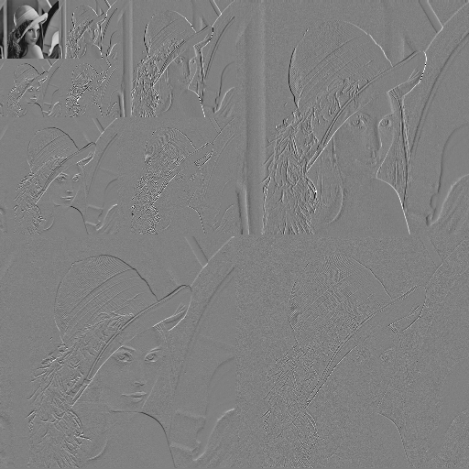

Multiresolution and multipriority
2003 NAIST-COE International Symposium
<number> / 10

Slide 18
The JPEG-2000 Approach
Combine Multirsolution with Multi-quality (bit planes encoding)
Multiresolution
Multiquality
Coding
Smart
Filter
Multiresolution
Transform
Quantisation
Region of
Interest
2003 NAIST-COE International Symposium
<number> / 10

Slide 19
JPEG 2000 Advantages
Lossless/Lossy
Flexibility - Scalability:
  Resolution
  Quality
  Spatial
  Region of interest
  Dynamic representation
Suited for Ubiquitous and Huge Image accesses
2003 NAIST-COE International Symposium
<number> / 10

Slide 20
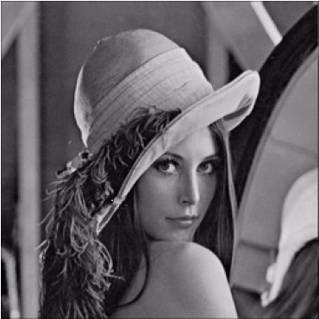
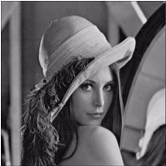


Scalability: progressive by resolution
2003 NAIST-COE International Symposium
<number> / 10

Slide 21
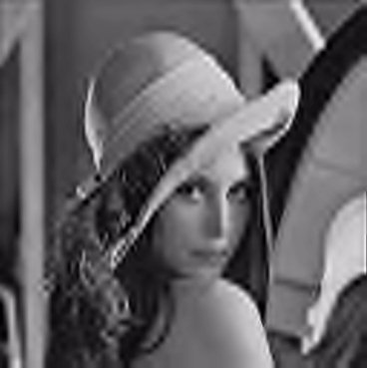
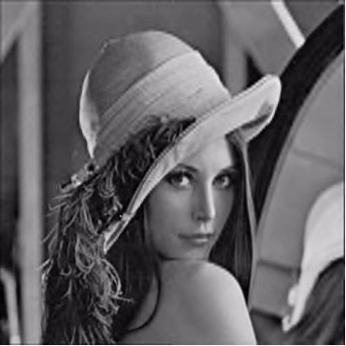
Scalability: progressive by quality
2003 NAIST-COE International Symposium
<number> / 10

Slide 22
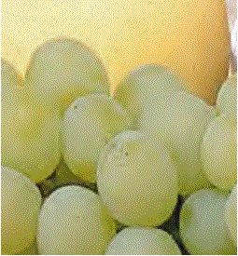
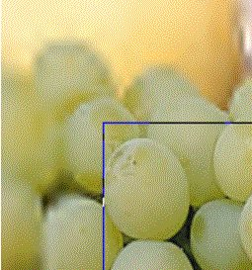
Region Of Interest
NO ROI
Rectangular ROI
2003 NAIST-COE International Symposium
<number> / 10

Slide 23
JPEG 2000 Overview
Image
Component
Transform
2003 NAIST-COE International Symposium
<number> / 10

Slide 24
High resolution grid, image
components and tiling
(XTsiz)
(0,0)
T0
T1
T2
T3
T4
T5
(ax,ay)
T6
T7
T8
T9
T10
T11
(YTsiz)
T12
T13
T14
T15
T16
T17
T18
T19
T20
T21
T22
T23
(bx-1, by-1)
T24
T25
T26
T27
T28
T29
Image Area
2003 NAIST-COE International Symposium
<number> / 10

Slide 25
JPEG 2000 Overview
Image
ROI
Component
Transform
Wavelet
Transform
Quant.
2003 NAIST-COE International Symposium
<number> / 10

Slide 26
Wavelet Transform and Quantization
Wavelet Transform
Tile independent
Reversible (Integer5/3)
Irreversible (floating point 9/7)
Dyadic decomposition
Several levels of decomposition
Quantization
Scalar quantization
Separate stepsize for each subband
2003 NAIST-COE International Symposium
<number> / 10

Slide 27
JPEG 2000 Overview
Image
Arithmetic
coding
Component
Transform
Wavelet
Transform
Quant.
Coefficient
bit model
Coefficient
bit model
2003 NAIST-COE International Symposium
<number> / 10

Slide 28
Codeblocks and
Bit-planes
Codeblocks
Each subband of each tile component is partitioned
into codeblocks
Each codeblock is compressed independently using
bit-plane coding
LSB
Bit-plane i
MSB
2003 NAIST-COE International Symposium
<number> / 10

Slide 29
Bit-plane coding
Quantized coefficients are represented in sign-magnitude
Leading “all-zero” bit-planes are skipped.
Each bit-plane is coded in three phases:
  Significance Propagation
  Magnitude Refinement
  Clean up
2003 NAIST-COE International Symposium
<number> / 10

Slide 30
Arithmetic entropy coding
Coefficient
bit model
Decision
Arithmetic
coding
Quantified
Coefficient
Compressed
image data
Context
The context represents the significance status of the
eight spatial neighbour coefficients
The MQ-coder estimates the probability of significance
of the current coding symbol.
2003 NAIST-COE International Symposium
<number> / 10

Slide 31
JPEG 2000 Overview
Image
ROI
Arithmetic
coding
Rate
Control
Component
Transform
Wavelet
Transform
Quant.
Coefficient
bit model
2003 NAIST-COE International Symposium
<number> / 10

Slide 32
Layers Abstraction
Quantified Coefficients
Rate-distortion
optimisation
(non standardised)
BC
BC
BC
BC
Bit-streams
Layers Abstraction
Ln
B 1
B 2
B 3
B 4
B5
L1
L2
Layers
Layer 4
empty
empty
A layer is a quality
increment for an
entire tile
Layer 3
Layer 2
empty
Layer 1
empty
2003 NAIST-COE International Symposium
<number> / 10

Slide 33
JPEG 2000 Overview
Image
Arithmetic
coding
Rate
Control
Component
Transform
Wavelet
Transform
Quant.
Coefficient
bit model
Data
Ordering
Codestream
2003 NAIST-COE International Symposium
<number> / 10

Slide 34
Data Ordering
The basic unit consist of a layer from each precinct
The progression order is determined by ordering of
packets in the codestream
Five progression orders are supported via index nesting
order:
  - Layer - resolution - component - position
  - Resolution - layer - component - position
  - Resolution - position - component - layer
  - Position - component - resolution - layer
  - Component - position - resolution - layer
The progression order can be changed within the
codestream
2003 NAIST-COE International Symposium
<number> / 10

Slide 35
Example Data Ordering
Layer - resolution - component - position
L1
L2
R1
R2
R1
R2
C1
C2
C3
C1
C2
C3
C1
C2
C3
C1
C2
C3
P1
P2
P1
P2
P1
P2
P1
P2
P1
P2
P1
P2
P1
P2
P1
P2
P1
P2
P1
P2
P1
P2
P1
P2
Resolution - layer - component - position
R1
R2
L1
L2
L1
L2
C1
C2
C3
C1
C2
C3
C1
C2
C3
C1
C2
C3
P1
P2
P1
P2
P1
P2
P1
P2
P1
P2
P1
P2
P1
P2
P1
P2
P1
P2
P1
P2
P1
P2
P1
P2
2003 NAIST-COE International Symposium
<number> / 10

Slide 36
Application in an integrated architecture (the PRIAM project)
Client
Server
GUI
Requ.
Manager
Protocol
Protocol
Parser
Decoder
J2K
Idx
Local J2K
Decoded data cache
Embedded
Coder
Parallel
Coder
J2000
Coder
Realisation in cooperation with Dr Suenaga from NAIST
2003 NAIST-COE International Symposium
<number> / 10

Slide 37
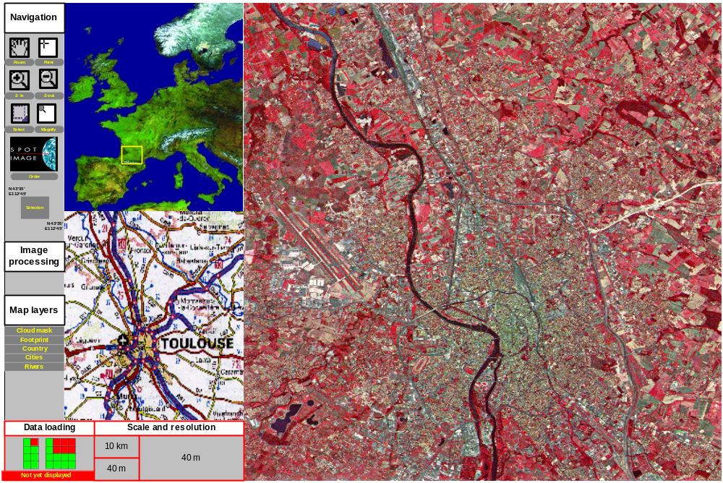
Example of navigation into mega-images
24000 * 24000 pixels towards 40000000 * 40000000 pixels
2003 NAIST-COE International Symposium
<number> / 10

Slide 38
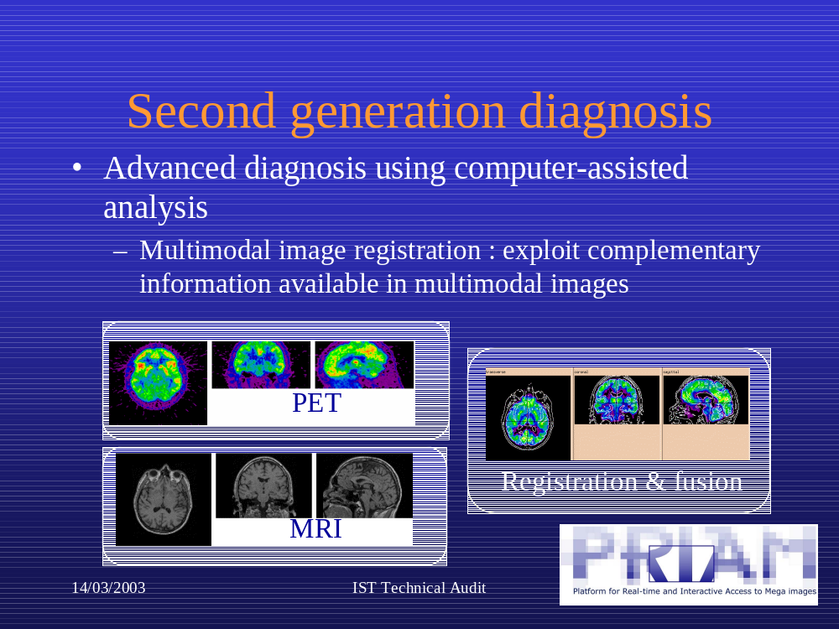
Validation in medical environment
2003 NAIST-COE International Symposium
<number> / 10

Slide 39
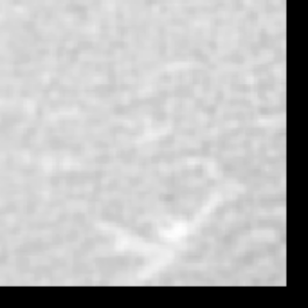
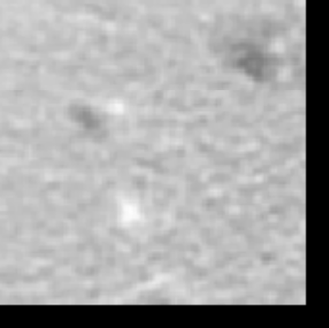
Experiments on CT Images I
Validation with Prof Dewey and Kathleen Steinhofel
An example of normal liver tissue
(negative example).
An example of tumour tissue
(positive example).
2003 NAIST-COE International Symposium
<number> / 10

Slide 40
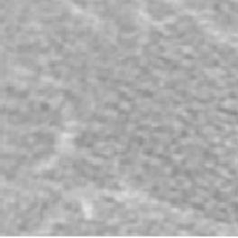





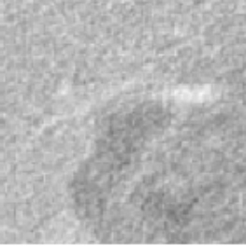

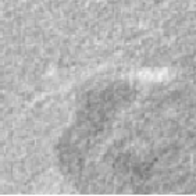

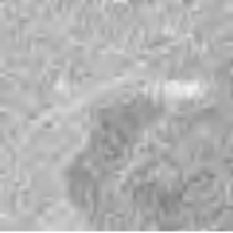
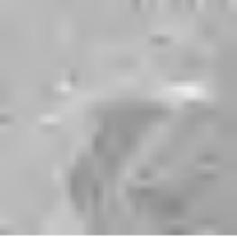
Experiments III: Different Rates
Original 50% 25% 10% 5% 2
PSNR 46.31 44.91 39.10 33.99 29.97
Original 50% 25% 10% 5% 2%
PSNR 45.85 38.90 32.74 29.76 27.42
2003 NAIST-COE International Symposium
<number> / 10

Slide 41
Experiments
 | Error on pos | Error on neg | Error in %
Org | 0 | 3 | 1.5
 | Cmp. Org. | Cmp. Org. | Cmp. Org.
50% | 4 4 | 2 2 | 3.0 3.0
25% | 2 2 | 2 2 | 2.0 2.0
10% | 0 1 | 1 1 | 0.5 1.0
5% | 2 3 | 1 3 | 1.5 3.0
2% | 4 3 | 1 1 | 2.5 2.0
2003 NAIST-COE International Symposium
<number> / 10

Slide 42
Conclusions
We promote the use of flexible bit streams representations for ubiquitous applications
An experiment was conducted (in cooperation with NAIST post-doc, Dr Suenaga and Dr Umeda from Prof Chihara Laboratory) in the frame of the PRIAM project
The concept has been validated to get access to large medical image databases containing huge images
Demo
2003 NAIST-COE International Symposium
<number> / 10

